Slide 1
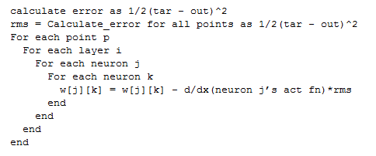

Slide 2
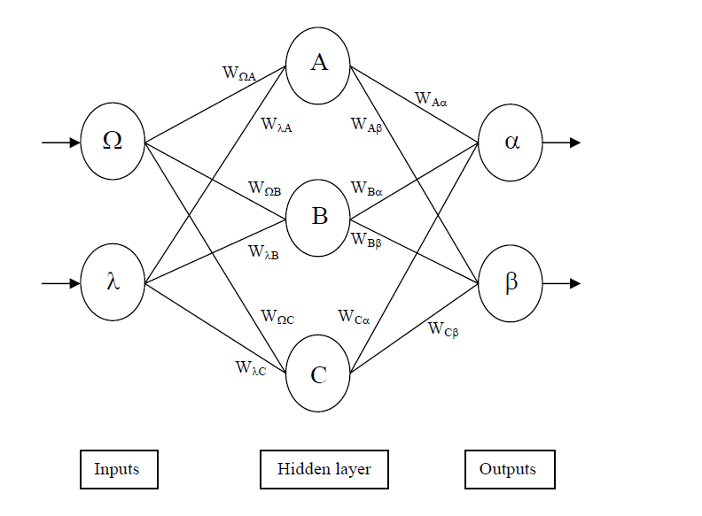

Slide 3
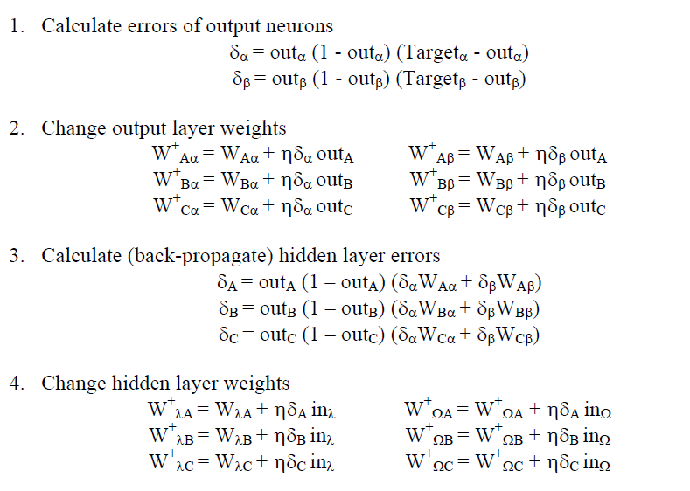
Calc_delta_out
Up_weights
Calc_delta

Slide 4
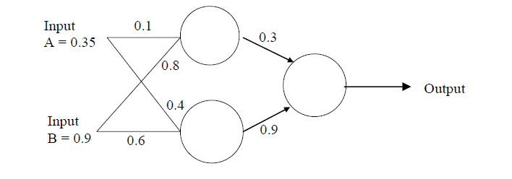
0
0
1
1
0 | 1 | 2
1
1
0.1 | 0.8
0.4 | 0.6
0.3 | 0.9

Slide 5
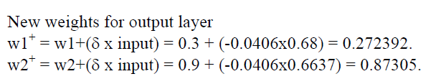
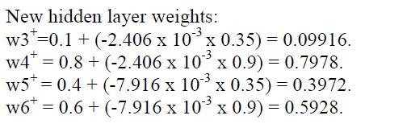
0 |  | 1 |  |  | 2
0.35 |  | 0.1 | 0.8 |  | 0.3 | 0.9
0.9 |  | 0.4 | 0.6
0 |  | 1 |  |  | 2
1 |  | 0.09916 | 0.7978 |  | 0.27236 | 0.872998
1 |  | 0.3972 | 0.5928

Slide 6
E = ½(Err^2)
E = ½(t_p – o_p)^2
Change in Error with respect to
Change in weight
j
W_jk
k
k
k
k
k
k

Slide 7
0
0
1
1
0 | 1 | 2
1
1
0.1 | 0.8
0.4 | 0.6
0.3 | 0.9

Slide 8
Ffwd with Bias
1
1
1
bias
bias
Ffwd output should be
(0.3*0.8526)+(0.9*0.8429)+1
subs(sig, 2.0144) = 0.8823

Slide 9
Back Propagation
(0.5 - 0.8823)*(1-0.8823)*(0.8823)

